Slide 1
ETRSS-1 Thermal Control Subsystem Critical Design and Orbit Operation （Chapter 7-11）
DFH SATELLITE CO.,LTD
February.2019

Slide 2
Contents
FOREWORD
TRODUCTION OF TCS
3 SATELLITE DESIGN ACCORDANCE
4 TECHNICAL REQUIREMENTS
5 SUBSYSTEM CRITICAL DESIGN
6 SUBSYSTEM INTERFACE DESIGN
7 Thermal ANALYSIS
8 RELIABILITY ANALYSIS
9 SUBSYSTEM BUDGET ANALYSIS
10 THERMAL BALANCE TEST
11 DESIGN CONCLUSION

Slide 3
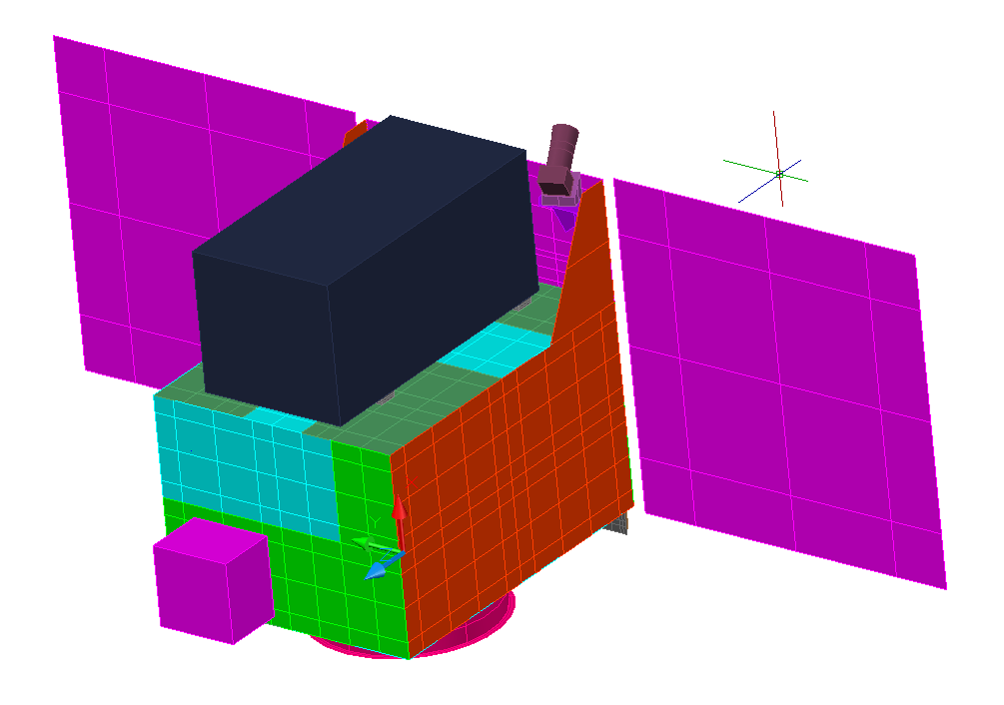
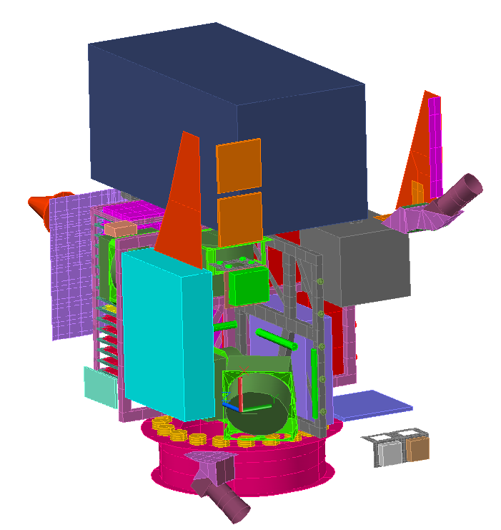
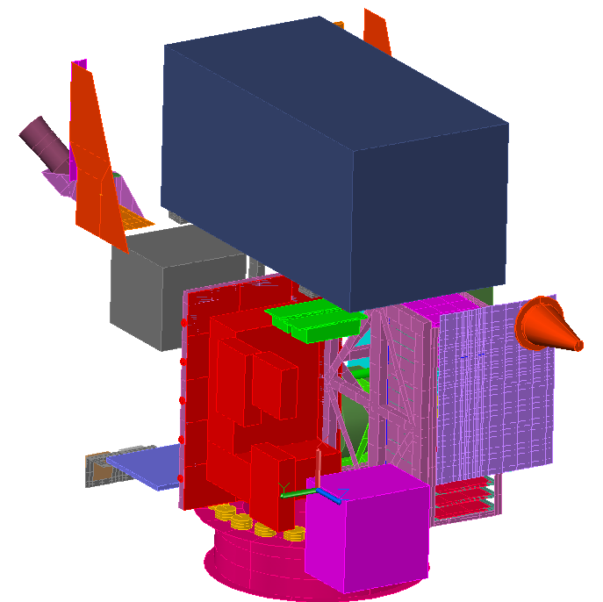
7 Thermal Analysis
------ Software And Nodal Network
The software Thermal Desktop is used to accomplish satellite analysis.
Thermal model algorithm is used the finite difference method.
Space environment temperature is 4K.
Analysis model nodal number is about 1690.
The External Surface Thermal Analysis Model

Slide 4
7 Thermal Analysis
------ Thermal Physical Model Description
Each unit except for power control unit is modeled as a single node.
The conductance between unit and its mounted surface is considered as contact conductance, neglecting other conductance form.
Cameras is simplified in the model and is set by a boundary temperature of 20℃.
Ignore the effect of pipelines.

Slide 5
7 Thermal Analysis
------ Thermal Network Model Description

Slide 6
7 Thermal Analysis
------ MODELLING DATA
Conductive Properties
Heat Capacities
---910J/Kg℃ for aluminum structure thermal capacity
---Unit thermal capacities coming from IDS
Contacting Heat Transfer Coefficient
--- Contact (no inter-filler)： h=100W/ (m²K)
--- Full Contact (with inter-filler)： h=1000W/ (m²K)
---Heat pipe/Heat pipe(with inter-filler)： h=1000W/ (m²K)
Definition | Conductive properties（W/(m·K)）
 | λxy | λz
Aluminum Honeycomb Panel | 1.4 | 1.5
Aluminum LY12 | 121

Slide 7
7 Thermal Analysis
------ Thermal Optical Properties
Thermal Optical Properties
Coatings | Location | Solar absorptance α_{S} |  | Emittance ε_{h}
 |  | BOL | EOL
Aluminum | Structure panels | - | - | 0.1
Black paint | Surface of equipment | 0.93 | 0.93 | 0.88
Black anodized aluminum | Surface of equipment | 0.90 | 0.90 | 0.88
White paint | Selected spacecraft interior | - | - | 0.87
Single aluminized Kapton | MLI blanket (outer layer) | 0.35 | 0.65 | 0.67
Clear anodized aluminum | External components | 0.15 | 0.50 | 0.65
OSR | External radiator | 0.135 | 0.26 | 0.79
Silvered Teflon film | External surface | 0.15 | 0.40 | 0.68

Slide 8
7 Thermal Analysis
------ Critical cases
Cold Case
Case 1(Safe mode). BOL, on June 2th. Satellite is in attitude safe model with -Z axis points to sun. All the payloads are switched off and heaters are on.
Case 2(Worst cold): Satellite is in normal 3-axis stabilized state, and the satellite is in attitude with -Z axis points to sun in sunshine zone, with +Z axis points to earth in Shadow . All the payloads are switched off and heaters are on.

Slide 9
7 Thermal Analysis
------ Critical cases
Hot Case
Case 3(Worst hot 1, Playback Mode): Attitude similar to Case2, on Feb 9th, EOL, work time of playback mode is shorter than 10 min on one orbit.
Case 4(Worst hot 2, Record Mode): Attitude similar to Case2, on Feb 9th, EOL, work time of Record mode is shorter than 10 min on one orbit.
Case 5(Worst hot 3, Record and Replay Mode): Attitude similar to Case2, on Feb 9th, EOL, work time Record and Replay Mode is shorter than 10 min on one orbit.
Case 6(Worst hot 4, Real-Time Transport Mode): Attitude similar to Case2, on Feb 9th, EOL, work time of Real-Time Transport Mode is shorter than 10 min on one orbit.

Slide 10
7 Thermal Analysis
------ Orbit Fluxes Parameter
Cold Case ： S=1323W/m² The orbit beta angle β=16.98° June 2th
Albedo Radiation Value=0.3 Planet shine Radiation value=231.53W/m²
Hot Case： S=1414W/m² The orbit beta angle β=26.18° Feb 9th
Albedo Radiation Value=0.35 Planet shine Radiation value=247.45W/m²

Slide 11
7 Thermal Analysis
------ Payload Operation Status
All the payloads are switched off in cold cases.
Payload work time and mode is shown in Table8-1 in hot cases.
Table 8-1 Payload Operation Time in Hot Cases
 | Case No. | Case3 | Orbit
Hot Case | Worst hot 1 | Replaying 10min； | β =27.1°(2020.2.9)
 | Worst hot 2 | Recording 8min；
 | Worst hot 3 | Recording 3.5min & Replaying 5min；
 | Worst hot 4 | Real-Time Transport 4min

Slide 12
7 Thermal Analysis
------ Temperature Prediction
Thermal Analysis Reasults
In cold cases, all the payloads are off. Satellite units temperature are in the range of -5.8℃~31.8℃. The battery temperature is in the range of 17℃~19℃. DCDC units temperature is -2.8℃~12.6℃. Star Sensor units temperature is -5.8℃~11.3℃The temperature where Camera contact is -2.5℃~9.5℃.There is at least 10℃ margin between flight predicted temperature and design temperature.
In hot cases, all the payloads work according with procedure. Satellite units temperature are in the range of -5.5℃~40.1℃. The battery temperature is in the range of 17.6℃~19.5℃. DCDC units temperature is 10℃~26.4℃. Star Sensor units temperature is -7.5℃~28℃,The temperature where Camera contact is 3.2℃~19.7℃.There is at least 10℃ margin between flight predicted temperature and design temperature.

Slide 13
7 Thermal Analysis
------ Temperature Prediction in attitude maneuver
Because the duration of attitude maneuver is shorter than 4 min. The temperature deviation of the satellite units is less than 3℃，according to the flight experience of other satellites.
Thermal design satisfies temperature requirements and has enough temperature margins.

Slide 14

8 RELIABILITY ANALYSIS
------ TCS Reliability
The reliability value of all the heaters
Thermal control subsystem reliability:

Slide 15
8 RELIABILITY ANALYSIS
------ FMEA
Random failure with catastrophic consequences are not expected for thermal components (OSR, MLI, Thermal Control Coatings), but only gradual degradations. Aging effects on these elements are introduced in thermal analysis which considers end of life conservative values.
Concerning HP. they are grouped into batches so that it is possible to have a complete loss of one HP at any place with acceptable degradation of the thermal performance.
Concerning Heaters, the failures in the FMEA sheet which cause ‘permanent heating’ or ‘no heating’ have consequently a low probability of occurrence.

Slide 16
8 RELIABILITY ANALYSIS
------ Derating Properties of Thermal Hardware

Slide 17
8 RELIABILITY ANALYSIS
------ Redundancy-Single Point Failure
Redundancy
Each heater has redundancy and so does thermistors used for temperature monitoring and control
Single point failure modes
The SPF shall be eliminated.
Failure safety
The effects of failure of equipment elements upon other elements shall be minimized.

Slide 18
9 BUDGET ANALYSIS
------ Mass Budget

Slide 19
9 BUDGET ANALYSIS
------ Power Consumption Budget
Heater Location | Number of Heater | Heater Power(designed)（w） | Heater Power(actual worked)（w） |  |  |  |  |  | Remark
 |  |  | Case1 | Case2 | Case3 | Case4 | Case5 | Case6
Battery1 | 1＋1(R) | 5 | 45% | 36% | 0 | 0 | 0 | 5% | Long term power
Star Sensor | 1＋1(R) | 5 | 5 | 50% | 42.1% | 0 | 0 | 0 | Short term power
Data transmission | 1＋1(R) | 5 | 59.6% | 61.9% | 0 | 0 | 0 | 0 | Short term power
Antenna | 1＋1(R) | 5 | 0 | 0 | 0 | 0 | 0 | 0 | Short term power
Requirement | Long term power≤8.8W(Average Power)
 | short term power ≤20W

Slide 20
9 BUDGET ANALYSIS
------ Specification Compliance
Content | Technical Requirements | Thermal Design | Compliance | Remark
Component Operational Temperature | According to the requirement | Shown in Tab 7 | C | Analysis
weight | ≤3.5Kg | 3.4Kg | C | Budget
Heat Power Consumption | ≤20W | ≤20W | C | Analysis
Reliability | ≥0.995 | 0.99522 | C | Analysis
Design Life | 2 years | 2.3years | C | Analysis

Slide 21
10 THERMAL BALANCE TEST
------Satellite Configuration And Criteria of Test
Object:
Verify the thermal design, examine the performance of TCS
Thermal design mainly depends on numerical simulation
The correctness and rationality of the simplified model and assumption ?
Errors of the simulation: model simplification, inaccuracy of the input parameters, not all the influence factors are considered
Real products will be more complicated
So the function and performance of TCS should be examined
Obtain the satellite temperature and modify the thermal analysis model
Modify the numerical model according to the tested results
Predict the temperature distribution more accurately

Slide 22
10 THERMAL BALANCE TEST
------Satellite Configuration And Criteria of Test
Satellite Configuration
Flight thermal control hardware
Flight equipment units
Tanks are empty
No antenna
No Solar Array
Criteria of Stability for Thermal Balance Tests
for steady state and for 85% of all supervisory thermocouples on units :dT/dt <0.1℃/hour during 4hours
for transient state and for 85% of all supervisor thermocouples on units :<1℃at same time in every period

Slide 23
10 THERMAL BALANCE TEST
------ Test Cases
Satellite TBT is a high price ground test, the tested cases will influence the testing period, developing process and cost
Sufficient analysis is required to determine the tested cases for TBT of thermal control model and flight model. Only if the testing objective can be satisfied, the fewer cases, the better.

Slide 24
10 THERMAL BALANCE TEST
------ Procedure of TBT
Procedure of TBT
Mainly stage included below in the whole procedure
Designing Stage of TBT
Preparing stage before TBT
Testing stage of TBT
Checking and analysis stages after TBT

Slide 25
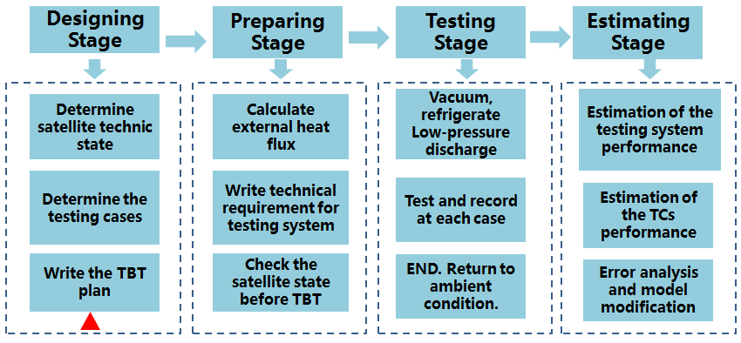
10 THERMAL BALANCE TEST
------ Procedure of TBT
Procedure of TBT

Slide 26
10 THERMAL BALANCE TEST
------ Test Cases
Working cases are complex during in-orbit flight
Orbit, attitude, configuration
Equipment heat consumption, working modes
Positions and directions of radiative heat dissipation surface
Optical properties of the thermal control coatings
Coating degradation in space

Slide 27
10 THERMAL BALANCE TEST
------ Test Cases
Worst hot case
Orbit: full sun
Attitude: Pointing to the sun
Working mode: max heat consumption
Degradation: performance of thermal control coatings (EOL)
Worst cold case
Orbit: longest shadow period
Attitude: back towards the sun
Working mode: min heat consumption or powered off
Degradation: Beginning of the lifetime (BOL)

Slide 28
10 THERMAL BALANCE TEST
------ Test Cases
Case 1 - Safe Mode, BOL, Steady State
Satellite -Z- axis points to the Sun.
Solar absorptivity of thermal coatings shall be taken normal value.
Payloads including cameras and DTS are turned off.
Heaters are enable.
Case 2 - Cold Mode, BOL, Steady State
Solar absorptivity of thermal coatings shall be taken normal value.
External heat fluxes are simulated as average of orbit period.
Payloads including cameras and DTS are turned off.
Other instruments shall be operating at their smallest heat dissipation mode.
Heaters are enable.

Slide 29
10 THERMAL BALANCE TEST
------ Test Cases
Case 3 - Hot Case1， EOL, Steady State
Solar absorptivity of thermal coatings shall be taken 2.3-year-degradation value.
Payloads including cameras and DTS work according to procedure.
External heat fluxes are simulated as average of orbit period.
Heaters are enable.
Recording 3.5 min & Replaying 5 min
Case 4 - Hot Case2， EOL, Steady State
Solar absorptivity of thermal coatings shall be taken 2.3-year-degradation value. Payloads including cameras and DTS work according with procedure.
External heat fluxes are simulated as average of orbit period.
Heaters are enable.
Real-Time Transport 4 min

Slide 30
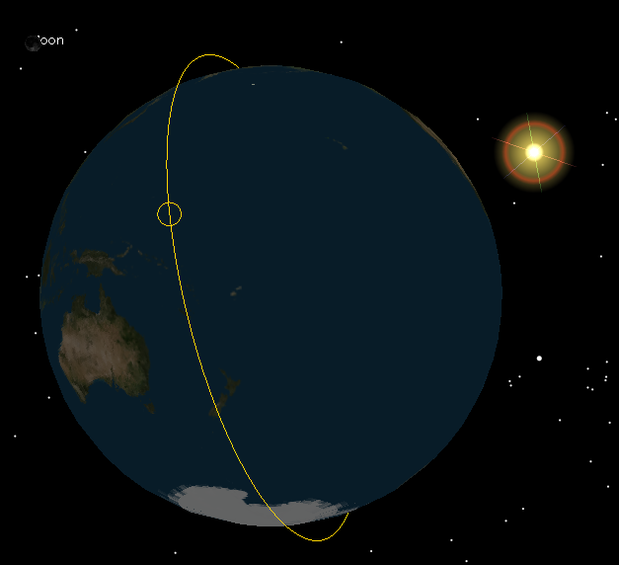
10 THERMAL BALANCE TEST
------ Test Method
Space environment simulation equipment
Characteristics of space environment
Vacuum
Extremely low temperature and black background
In-orbit external heat flux
It is difficult and not necessary to accurately simulate the in-orbit environment
Appropriate simplification is required

Slide 31
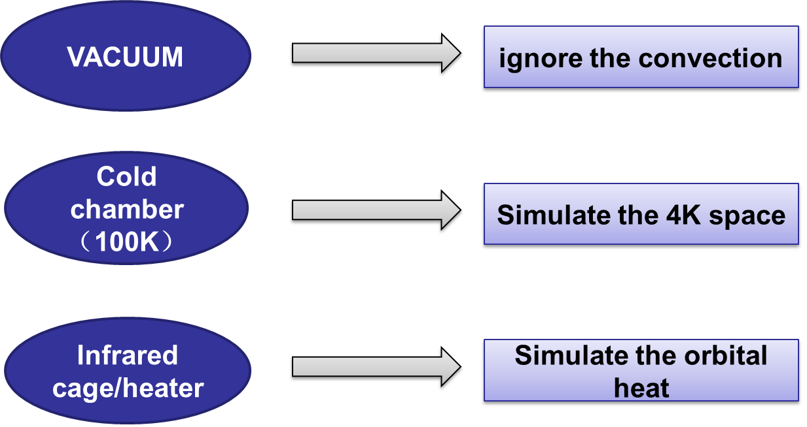
10 THERMAL BALANCE TEST
------ Test Method

Slide 32
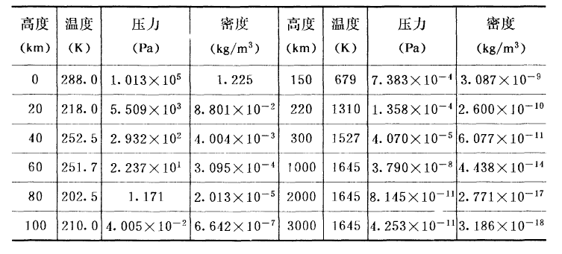
10 THERMAL BALANCE TEST
------ Test Method
Vacuum simulation
Pressure ≤ 10⁻⁵Pa at the altitude of 300km
Heat transfer: pressure = 10⁻³Pa, Satellite surface temperature=300K Conductive heat transfer = 0.33% Radiative heat transfer (ε=0.1)
”Pressure ~ 10⁻³Pa → vacuum space” can be accepted

Slide 33
10 THERMAL BALANCE TEST
------ Test Method
Extremely low temperature simulation
Effective radiative temperature of space=4K, difficult to simulate
Liquid nitrogen is usually adapted to simulate the low temperature environment
Saturated temperature of liquid nitrogen at 1 bar is 77K.
The equivalent radiative heat flux is 2W/m²
0.14% of solar constant, 1% of the average IR heat flux of Earth
The inaccuracy can be neglected in engineering fields

Slide 34
10 THERMAL BALANCE TEST
------ Test Method
Black background simulation
Black background: No radiation can be reflected by space as long as it goes into space. In other words, all of the radiation of the satellite will be absorbed by the black ground.
Heat sink made from Al（aluminium）, Cu（cuprum）, Stainless material → space
Pipes filled with cooling medium will be jointed to the inner surface of heat sink. The pipe surface is covered by black paintings (emissivity > 0.9)
Simulation error can be controlled within ± 1% at the temperature of about 20 ℃
Error will be larger at low temperatures

Slide 35
10 THERMAL BALANCE TEST
------ Test Method
External heat flux
For low-altitude spacecraft:
Direct solar irradiation
Solar spectral range: visible and near IR range
Reflected solar heat flux from the earth
Solar spectral range
IR radiation heat flux from the earth
Middle IR and far-IR spectral range

Slide 36
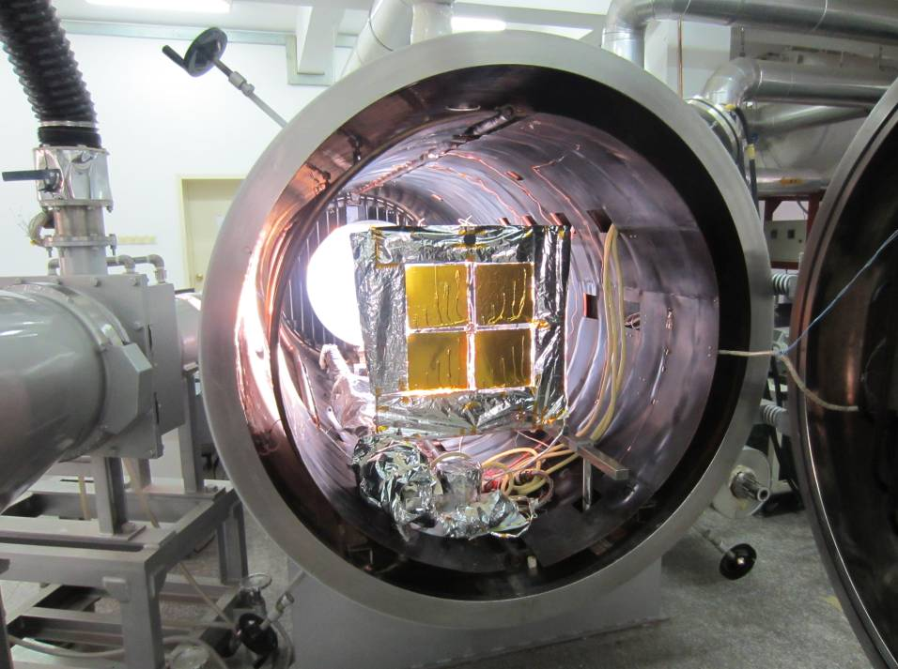
10 THERMAL BALANCE TEST
------ Test Method
Simulation method of external heat flux
Irradiation heat flux method:
Simulate the radiation intensity, direction and spectral characteristic (sun simulator)
Sun simulator
Includes: light source, optical system, cooling system, control system
Light source: Xenon lamp → spectral filter → solar spectra

Slide 37
10 THERMAL BALANCE TEST
------ Test Method
Absorbed heat flux method:
Make the absorbed heat flux at ground equals the external heat flux in-orbit by heating the spacecraft such as IR cage, IR lamp array, and electric resistant heaters. The spectral characteristic of the external heat flux in orbit will not be considered.
External heat flux simulation equipment
Radiative equipment: Sun simulator, IR lamp array, IR cage, Radiative heating panel
Conductive equipment: surface electric resistant heater

Slide 38
10 THERMAL BALANCE TEST
------ Test Method
According to the characteristic，plan and cost of ETRSS-1, IR cage method is chosen as external heat flux simulation .
The following contents are introduced about IR cage.
Far IR heating cage (IR cage)
Multiple heating loops are included in IR cage. Each heating loop can be controlled independently.
IR cage is constructed by heating belts (width = 10mm). The side facing satellite is covered by black paintings to obtain high heating efficiency.
Heating belts are connected by metal frame, so it looks like a cage

Slide 39
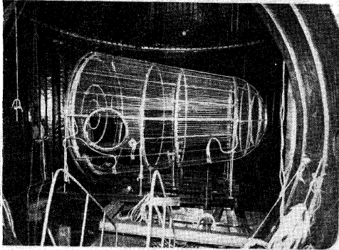
10 THERMAL BALANCE TEST
------ Test Method
IR cage (External heat flux simulation equipment)
The external heat flux absorbed by the spacecraft is large, so that the temperature of IR cage is high, which brings some difficult in the manufacturing, assembling and running.
In order to solve the high-temperature and transient-running problems, integral average method is adapted for the in-orbit external heat flux simulation
IR Cage

Slide 40
10 THERMAL BALANCE TEST
------ After Test
Checking and analysis stage after TBT
After TBT, the thermal balance should be re-calculated to verify the accuracy and efficiency of the tested results by comparing the satellite absorbed and radiated heat
The satellite absorbed heat includes: equipment heat consumption and the external heat flux absorbed by satellite surface
The radiated heat can be calculated by the temperature distribution of the satellite outer surface, emissivity and area.
The difference between the absorbed and radiated heat should be kept within ±10%.
Modification of the simulation model
a. Perform in-orbit thermal analysis and simulation with the modified model.
b. Optimize the thermal design, and prepare data foundation for detailed design .

Slide 41
11 DESIGN CONCLUSION
The thermal control designed for ETRSS-1 allow fulfilling all these requirements under worst conditions met during the whole life time.
The thermal design, as well the mathematical model developed for ETRSS-1 will be qualified during the thermal balance test.

Slide 42
！
Thanks！
Thanks！

